Slide 1
Machine Learning with Graphs
Baode Gao
2021.03.29

Slide 2
Outline
Introduction of graphs (Why graphs)
Models and Challenges (Spatial-based and Spectral-based)
Future plan

Slide 3
Introduction of graphs
Baode Gao
2021.03.29

Slide 4
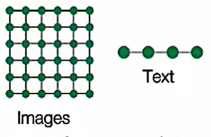
Introduction of graphs
Modern ML Toolbox
But not everything can be represented as a sequence or a grid.

Slide 5
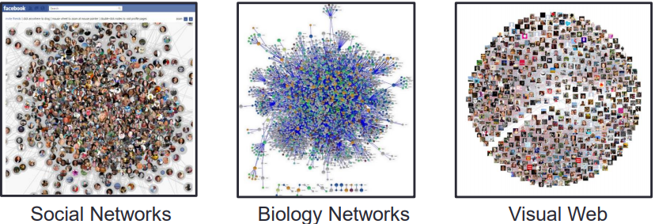
Introduction of graphs
Why we care about graphs (networks)?
A general language for describing and analyzing complex systems with relations/interactions.

Slide 6
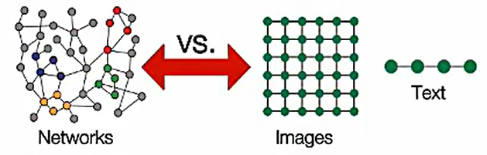
Introduction of graphs
Networks are complex!
Arbitrary size and complex topological structure
No fixed node ordering or reference point
Often dynamic and have multimodal features

Slide 7
Introduction of graphs
Ways to analyze networks
Node classification
Link prediction
Community detection
Network similarity

Slide 8
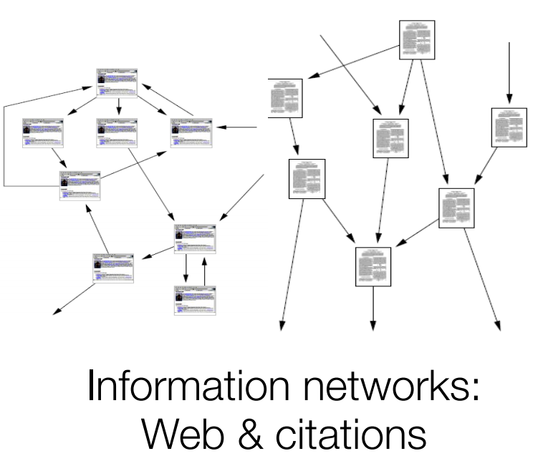
Node classification

Slide 9
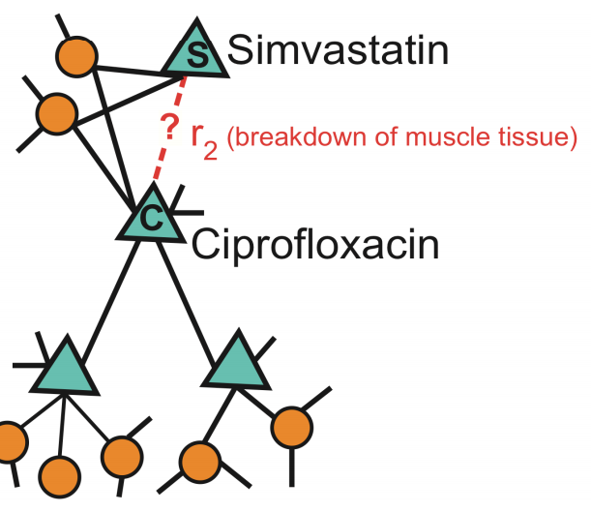
Link prediction
.

Slide 10
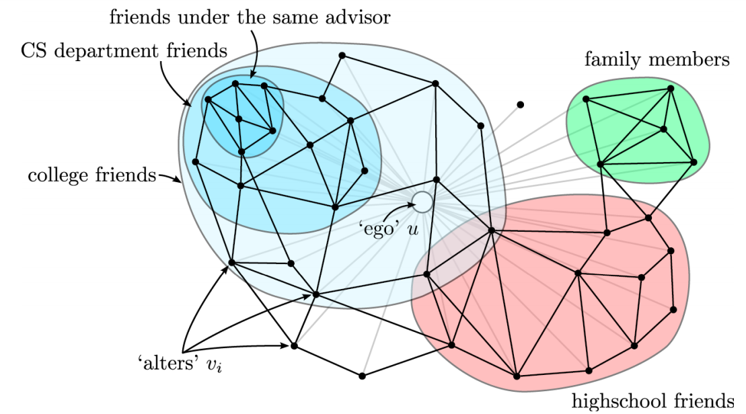
Community detection

Slide 11
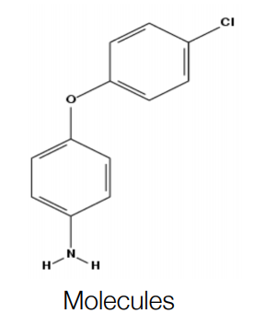
Network similarity

Slide 12
Models and challenges
Baode Gao
2021.03.29

Slide 13
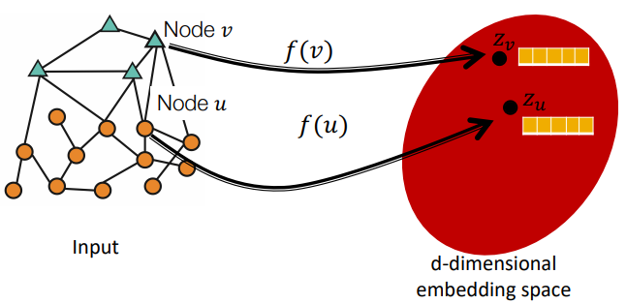
Models and challenges
Goal: Map nodes to d-dimensional embeddings such that nodes with similar network neighborhoods are embedded close together

Slide 14
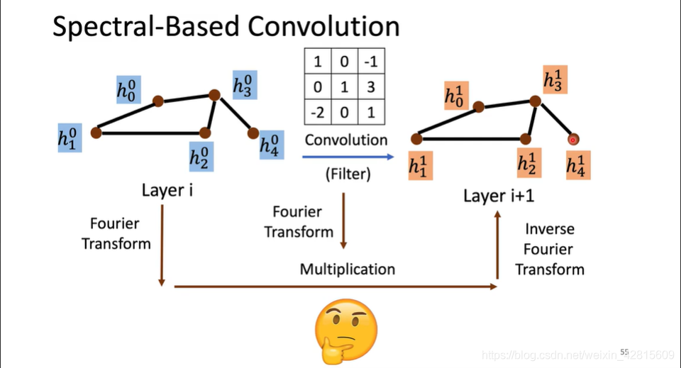
Spectral-based convolution

Slide 15
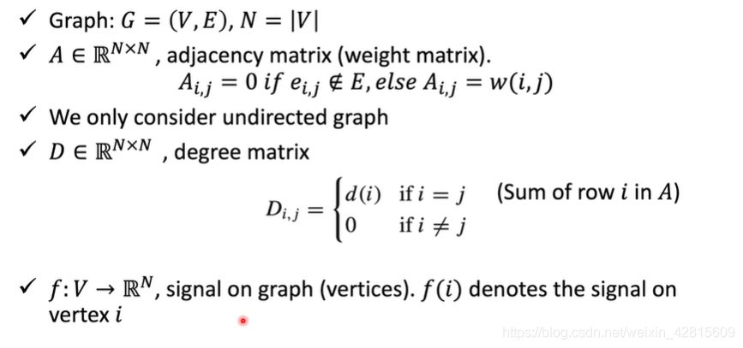
Spectral-based convolution
Spectral Graph Theory

Slide 16
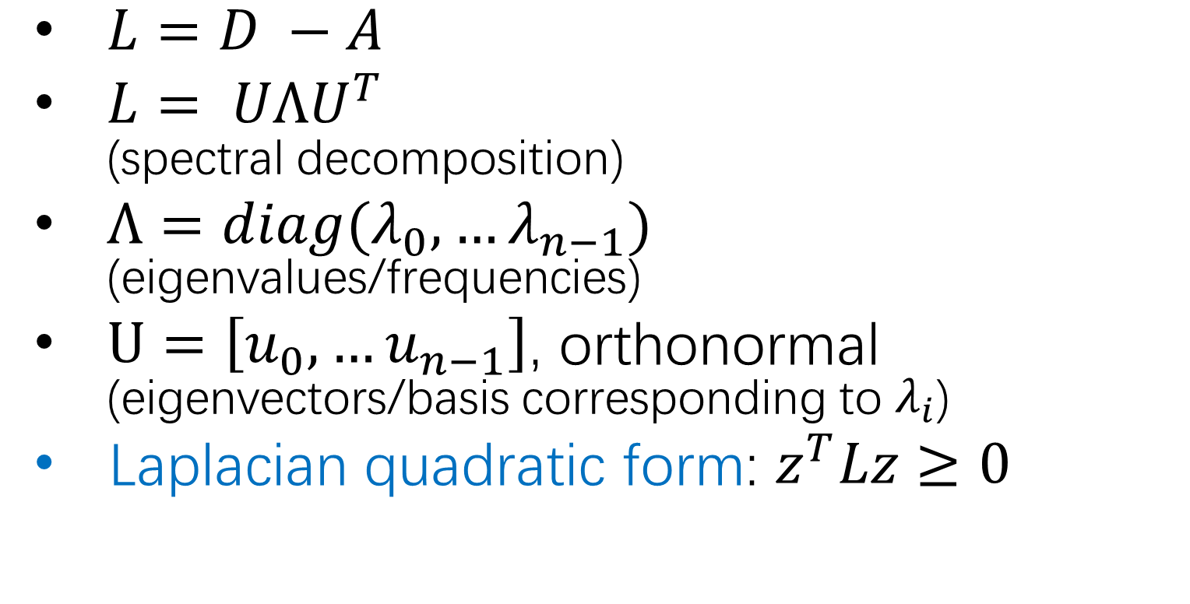
Graph Laplacian: positive semidefinite
$L=D −A$
$L= UΛU^{T}$ (spectral decomposition)
$Λ=diag(λ_{0},…λ_{n−1})$ (eigenvalues/frequencies)
$U=\left[u_{0},…u_{n−1}\right]$, orthonormal (eigenvectors/basis corresponding to $λ_{i}$)
Laplacian quadratic form: $z^{T}Lz≥0$

Slide 17
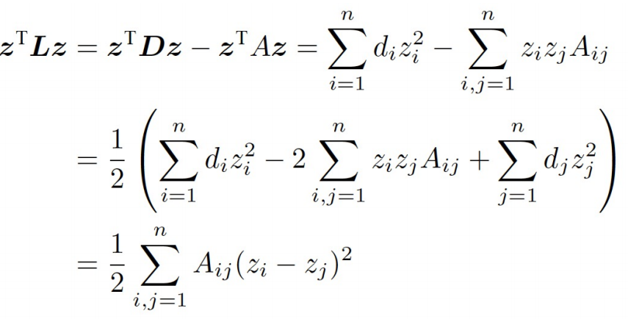

Laplace quadratic form
If z is the signal, then $z^{T}Lz$ means the “power” of signal variation between nodes. i.e. the smoothness of graph signal

Slide 18
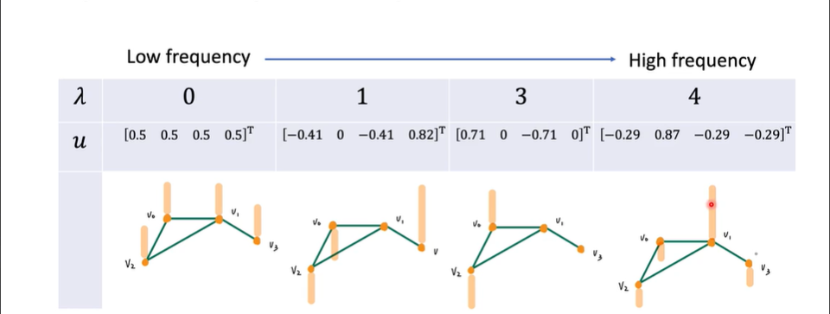
Relationships between frequency and smoothness

Slide 19
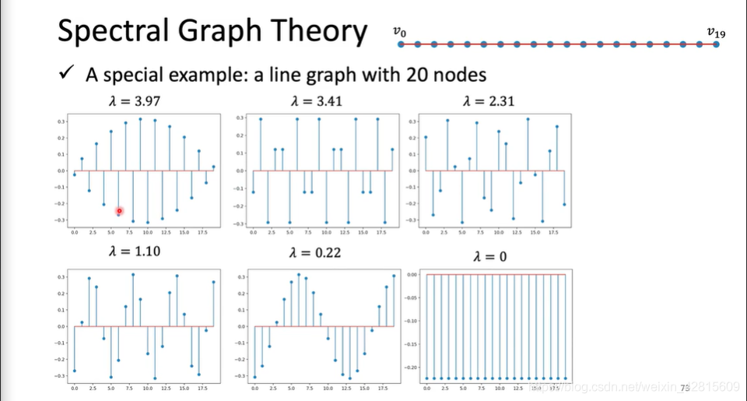
Relationships between frequency and smoothness

Slide 20
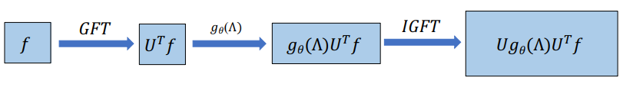
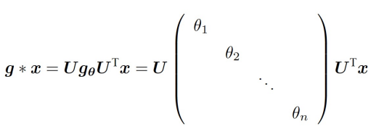
Graph Fourier Transform
Limitation: large amount of parameters, high time complexity and non localization

Slide 21


Spectral-based: ChebyNet(16)
A fast localization method based on Chebyshev polynomials
Fast recursive computation
K-localized and faster

Slide 22
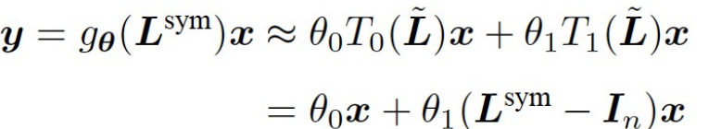

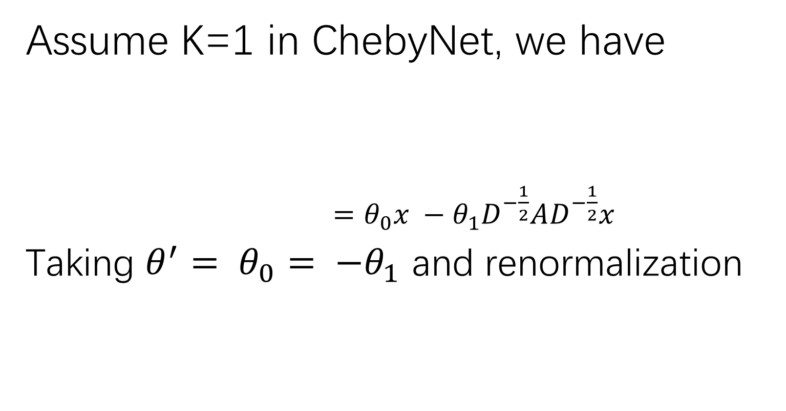
From ChebyNet(16) to GCN(17)
Assume K=1 in ChebyNet, we have
$=θ_{0}x −θ_{1}D^{−\frac{1}{2}}AD^{−\frac{1}{2}}x$
Taking $θ^{′}= θ_{0}= {−θ}_{1}$ and renormalization

Slide 23

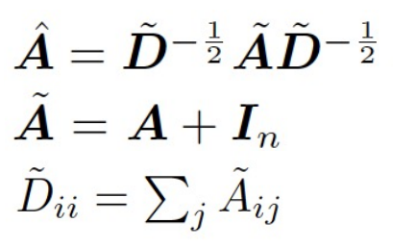
Spectral-based : GCN(17)
A two layers GCN:
Where,
GCN is low-pass filtering making signal Smoothing!

Slide 24
Challenges of GCN
Over smooth: dropout edge/other-pass filter?
Feature structure?
The unified framework

Slide 25
Spatial-based convolution
Terminology:
Aggregate: using neighbor feature to update hidden state of next layer, like mean, weighted sum and max pooling.
Readout(graph-level): Collect the features of all points to represent the graph.

Slide 26
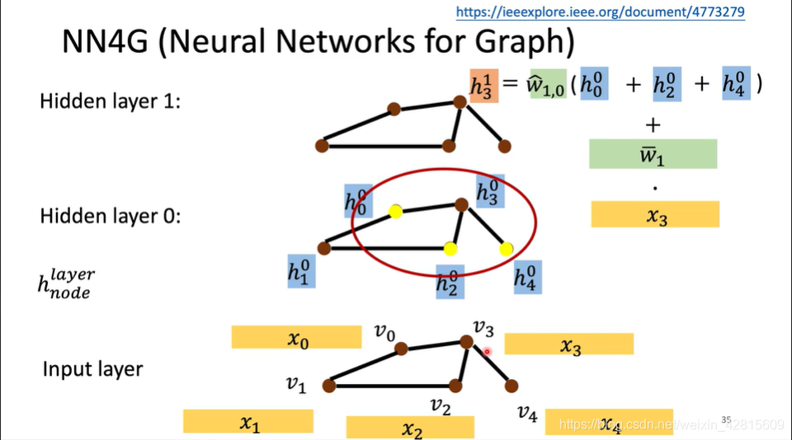
Spatial-based: NN4G(09)

Slide 27
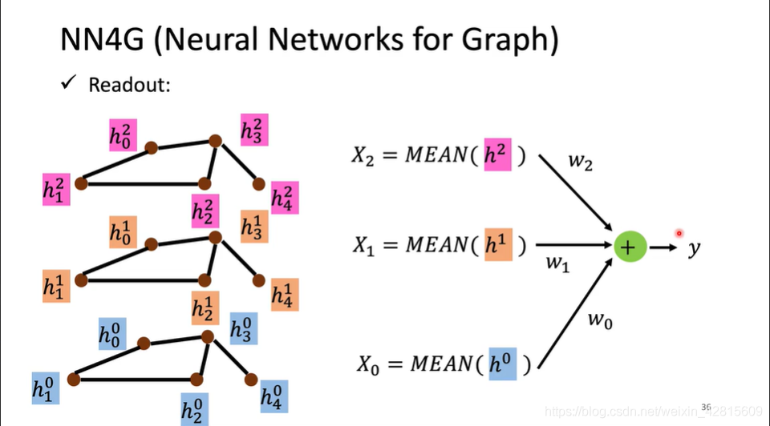
Spatial-based: NN4G(09)

Slide 28
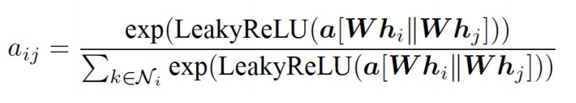
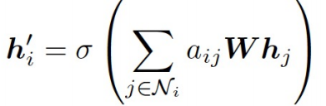
Spatial-based: GAT(18)
Attention formula between two nodes:
Massage passing:

Slide 29
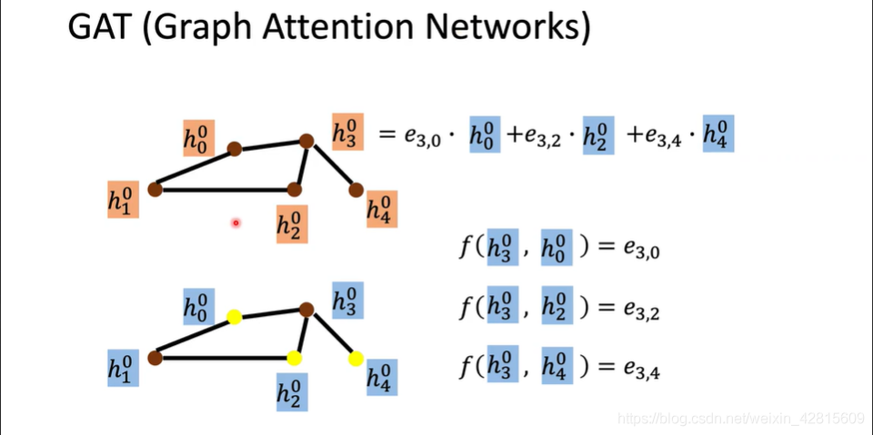
Spatial-based: GAT(18)

Slide 30
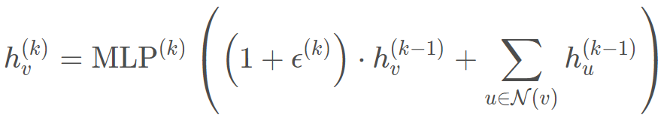
Spatial-based: GIN(19)
Graph Isomorphism Network:
A GNN can be at most as powerful as Weisfeiler-Lehman(WL) test
How can GNN be as powerful as WL test?

Slide 31
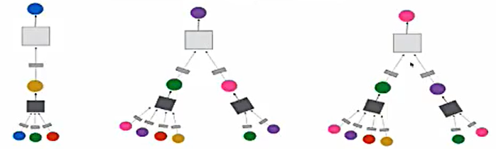
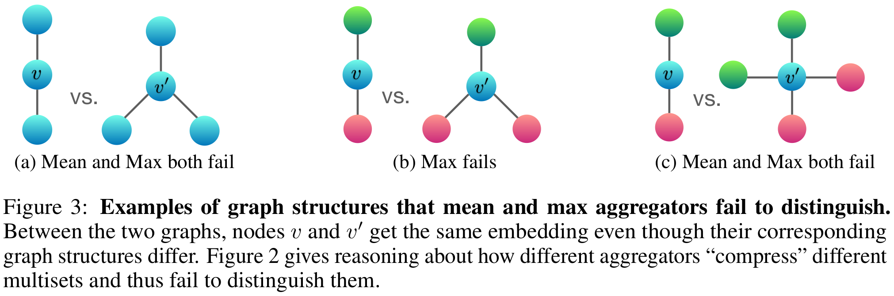
Spatial-based: GIN(19)
Node classification
Why sum?

Slide 32
Challenges of spatial-based methods
Neighbor explosion: sampling(node wise/layer wise/graph wise) based on information, for example, importance.
Applied in industry: efficiency
Feature structure

Slide 33
Spectral-based VS. spatial-based
Spectral-based:
pros: related to graph signal processing and convenient for analysis
cons: high computational complexity and not inductive learning
Spatial-based(main stream):
pros: unified framework, easy to understand and implement
cons: ?

Slide 34
Future plan
Baode Gao
2021.03.29

Slide 35
Thank you for your listening

